Slide 1
Introduction to applied Taxation ( Part 4.1-2023)
Course / Module Outline
Gross Income and the general deductions formulae.
  Section 8 (1)(a)
  Section 15 (2) and Section 16( highlights)
Taxation of corporates
  Gross income principles revision
  Specific Inclusions to gross income
  Exempt income
  Allowable deductions section 15
  Section 15(2c) and the 4rth Schedule
  Recoupment and scrapping allowances
  Other provisions

Slide 2
Recommended Textbooks
ICAZ Tax Module by Marvellous Tapera ( All Topics)
Sabelo Nare ( Mining , Farming and Partnerships)
Tax Legislation Latest Version.
To do Questions
2021 4102 Part 4,1 Paper
2022 4102 Paper
2023 4102 Paper
Other modular examples from various sources

Slide 3
Gross Income (Definition Section 8)
The total amount received by, or accrued to, or in favour of, a person or deemed to have been received or accrued in any year of assessment, from a source within or deemed to be within Zimbabwe, excluding amounts proved by the taxpayer to be capital in nature.
Amount
Amount means money or anything whether corporeal or incorporeal with an ascertainable monetary value ( CIR vs People).
What this means is even compensation in kind can be taxed if value can be placed on it
Example 1
A is in the farming business and decided to acquire a tractor from B Limited , however A is facing Cashflow challenges there decided to offer 30 cows and a standard value of 250 each as agreed with the commissioner.
Discuss the tax implications of the transaction below.

Slide 4
Received by
An amount is received by the tax payer when received by the tax payer for his won benefit. ( Geldenhuys Vs CIR)
What this means is the tax payer can do what he wants with the income so received. From this we can then conclude that an agent is not entitled to the income received on behalf of the principal
If an amount is received but its to be repaid then its not gross income CIR vs Genn
Example Received by.
The accountant at TSUN is pretty old and graduated 40 yrs. ago and is not quite conversant with the current tax matters and they consulted Ernst and Old Chatered Accountants
Students @ TSUN Private Limited pay registration fees when then are applying for a degree placement, this deposit is non refundable
They obtained a loan during the current year from First Mutual holdings from 100 million with an interest of 10% per annum (Refer to Further Discussion on Capital Nature)

Slide 5
Accrued to or deemed to accrue to
Accrued to means due and payable to Lategan Vs CR
Accrued to also mean entitled as per Hesorv Estate Case, The principles of accrual are more or less similar to our accounting principles,.
In its generality something is payable to you if there is a obliging event on either of the parties that creates an enforceable obligation that you have no realistic alternative to avoid but rather settle.
e.g. Unpaid fees at Nust
Deemed accruals: This are not actual accruals but the commissioner feels like making then accruals
1. Partnership income accrues on the date of accounting
2. Donations are deemed accruals Refer to section 10(3)
3. Section 10 (4) counteracts tax avoidance schemes. If a minor child becomes entitled to income in pursuance of a donation, etc. made by a third party

Slide 6
Source and Deemed source
The source of income is the location of the originating cause of income (CIR vs Lever Bros). The originating course is that act that gives rise to income.
The source of income is mainly determined with reference to case laws then section 12 , were the commissioner feels like taxing someone.
Sources of different incomes.
1. Leases , it is dependent on whether the asset is immovable or not , for immovable asset then its where the asset is located for immovable assets then we consider the length of the lease
short term (less than 5 yrs.) –its where the lessor conducts his operations
Long term ( greater than 5yrs) its where the asset is located
2. Credit – its is the provision of credit , thus where the credit is offered CIR vs Lever Bros
4. Intellectual property –its where the owner exercised his wit and labour Marlin Case
5.Dividends – the country where the share registry is located
6. Directors fees –ITC235 where the director can exercise his power as a director
7. A company into international trade e.g. Mining companies that send out their or for further processing in export countries and the ore is processed and sold there the true source is the dominant activity which is mining ( Transvaal association Skin )
8. Annuity – is where the annuity fund is located

Slide 7
Deemed source section 12
12 (1) (a) – Sale of goods by a person conducting business operations - The proceeds of any contract made in Zimbabwe for the sale of goods are deemed to be from a source within Zimbabwe
12 (1) (b) – Income from services rendered
> Payments are made outside Zim ,still taxed in Zimbabwe
>During a period of temporary Absence in Zim e.g. secondments your are taxed in zip
>When your services to the Zim government , you are taxed in Zimbabwe.
12 (2) Foreign interest and dividend income is taxed in Zimbabwe @ 20%
12(3) Foreign annuities when the right to the annuity was acquired while the annuitant was ordinary resident in Zimbabwe.
12(4) use of intellectual property ( refer to the Mirlin Case from the previous Slide)
12(5) Recoupment from a foreign country – refer to section 8(1)(i) and (8)(1)(j) discussion under specific inclusions

Slide 8
Capital in nature
The determination of whether income is capital in nature or note is dependent on the nature of the receipt and the intentions of the tax payer
Income arising from the disposal of the income generating body ( the tree) is capital in nature ( Visser Case and African Steel vs CIR)
Some times we consider the original and the change in the intentions of the tax payer, If the tax payer had originally bought the asset to earn income then its disposal is capital in nature (Lace Property Mines )
If however the intentions changed e.g. the asset is now held to have capital gains once the fair value increases, the change in intention warranted that the asset is held to earn income through capital gains hence the intent is to dispose of the asset when prices rise then the disposal will be revenue in nature.
Remember the loan receipt discussion we had in the previous slides lets tackle it in the next slide

Slide 9
Example of Capital Nature Receipts
Loan Interest
The treatment of the loan takes the form of the use the loan was put to ( IAS 23 borrowing costs), If a loan is used to service working capital the interest on loan in revenue in nature ,
if the loan is used in the construction or purchase of specified assets then the interest is capital in nature hence will also be deductible through capital allowance ( hold on to this we shall use it later )
Insurance receipt
An indemnity from an insurance company that is used to fill a hole in the capital assets its capital in nature ( Glenoid Vs CIR ) and when it is used to cover a hole in profits e.g. working capital then its revenue in nature ( Burman Steamship vs CIR)
Restraint of trade
As a natural person your are your own asset (you are the fruit) if your are then restricted to use your tree to produce fruits in a form or compensation is as good as you sold your tree , then the receipt is capital in nature

Slide 10
Allowable deductions
Deductions allowable shall be expenditure and losses to the extent to which they are incurred for the purposes of trade or in the production of income except to the extent to which they are expenditure or losses of a capital nature. (Sect 15 2 (a))
Expenditure and losses- expenditure is voluntary and losses are involuntary
expenditure involves creating a liability else were and payment to someone (
  losses can happen because of a misfortune e.g. theft and such can be deductible however if theft is done by someone who is deemed to be a proprietor then its not deductible ( Locke Brothers case)
2. For the purpose of trade – there need to be a close link between the expenditure and the tax payers trade , it should be a necessary concomitant of trade ( Joffe and Co and Port Elizabeth tramway case ).
3. To the extent – thus is an expenditure is incurred party for personal and partly for business then we have to apportion the expenditure
4 . Capital in nature – the determination of capital in nature expenditure is similar to what we discussed back then ( Fruit vs tree) Visser Case . An expenditure is capital in nature if it creates and enduring benefit as per George Forester Timber

Slide 11
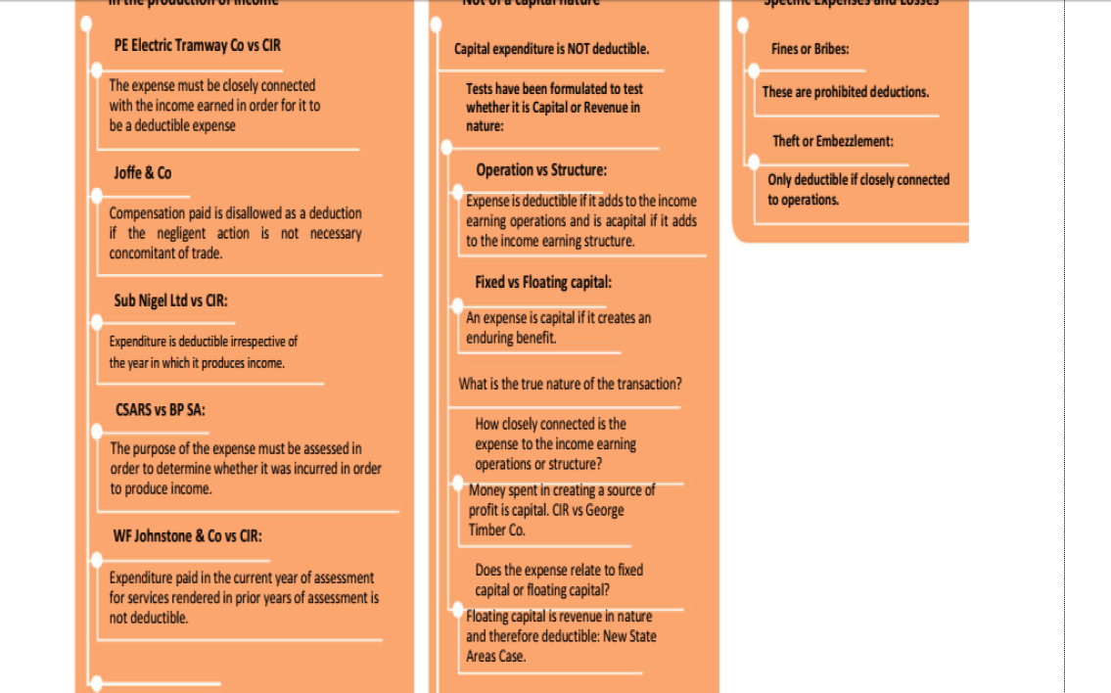
Applicable case laws

Slide 12
Taxation of business Income
Businesses as juristic personas are also subject to taxes and the source based provisions as per our previous discussions. Business are taxed at a rate of 24,72 which is 24+3% aids levy
Income tax is paid on quarterly basis in advance of year end on 25 March, 25 June, 25 September and 20 December at 10%, 25%, 30% and 35% respectively of estimated annual tax liability.
Examination Layout for your solutions
Computation of taxable Income
Details | Reason | Amount
Net profit | given | xxx
Adjust for non taxable items
Dividend income |  | xxx
profit on disposal |  | xxx
Capital Receipts |  | xxx
local interest income |  | xxx
Adjust for non deductible expenditure |  | xxx
Payments for restraint of trade |  | xxx
Underpinning costs, relocation costs , licencing costs |  | xxx
Entertainment |  | xxx
Fine for bribes and illegal expenditure |  | xxx
Loss from theft by owners |  | xxx
Theft from show flow employees which is insured |  | xxx
Taxable Income |  | xxx

Slide 13
Specific Inclusions into gross income
8(2)-Exchange gains and losses- they are included in the gross income when they are realised this means that book adjustment's are not gross income and you will have to remove them from such
8(1)(a) Annuities
We need to consider the source of this annuity , as per our discussion the source of a purchased annuity is where the fund is located , through its also deemed in terms of section 12(3) that the source is Zim if the right was purchased in Zimbabwe
There are different types of annuities
1.Purchased annuity
A purchased annuity is taxed to the extent of the interest component , what do we mean remember the received by provisions when he was paying or contributing to the annuity this contributions were actual capital in nature however the interest benefit then is the taxable benefit.
How do we then compute the benefit
=(P(N)-A)/N
Where P = annuity receipt on a annual basis
Where N= years of expected receipts
Where A = Amount expected on purchasing the annuity.
2. Annuity from inheritance- This type of an annuity is either taxable in full or not taxable in full depending on where the fund is situated. A widow ‘s pension, which is one example of this type of an annuity, is not taxable in Zimbabwe if it is situated outside Zimbabwe even though her late husband may have rendered services in this country in the past
3. Annuity from sale of capital assets –treatment is the same as the purchased annuity

Slide 14
Section 81d and 152d Lease premiums
Included are lease premiums which are paid by the lessor to the lesser. Please not to the lessor they are normal revenue since he is in the trade of renting our properties.
However from the hands of the lessee they represents a substantial expenditure hence the commissioner allowed the tax payer to spread the amount over the lower of the lease term (15 2d).
Lessor | Lessee
Gross income (taxable in full) | Deductible expenditure spread over the lower of the lease term and 10 yrs.

Slide 15
81(e) and 152(e) Lease Improvements
Its is normal business that a lessee effect improvements on the leased assets, this is usually to adjust the asset to meet the trading need of the lessor.
This is capital income in the hands of the lessor and more or less of capital expenditure in the hands of the lessee since it creates an enduring benefit. However the commissioner has made special treatment of the capital receipts
Lessor | Lessee
>Improvement are gross income to the extent of the contractual >improvements( thus excess improvements are not taxable) Improvements are spread over the lesser of 10 years and the unexpired lease period (the unexpired is measured from the date of completion of the improvements to end of the lease term) Capital Allowances Can claim wear and team on the improvements | Contractually Improvements are allowable as a deduction in the hands of the lease. The deduction is spread over the lower of the 10yrs and the unexpired lease period ( where the unexpired lease period starts from the date of the date of use to the end of the lease term) Voluntary Improvements These are deemed to create an enduring benefit hence subject to 152c and the tax payer can elect for SIA

Slide 16
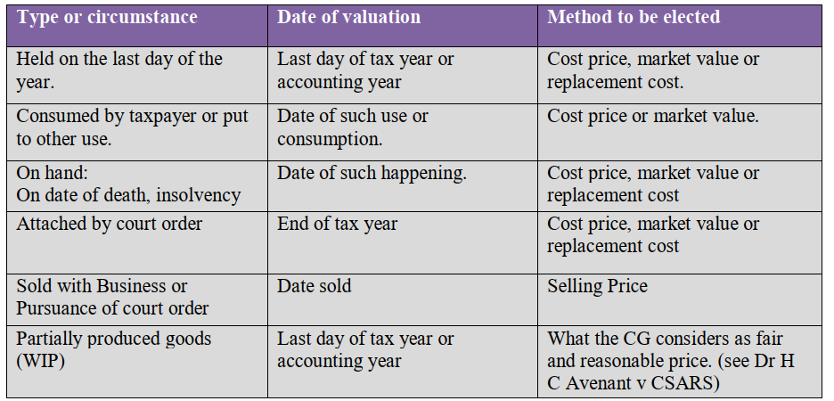
81k and 81H Cessation of credit and closing stock
Cessation of credit on deductible expenditure is gross income , the tax payer is simple saying I gave you’re a benefit before from deducting but now that you are no longer paying I have to benefit as well.
Conditions
-the expenditure should have been allowable as a deduction
-the deduction should have been done in the current period or in any year of assessment )
-Funny Fact -oppose this conditions you meet the conditions to deduct bad debts (152g) lol
8(1)(h) -Closing stock- closing stock is gross income

Slide 17
Exemptions Para 14 and 13th Schedule
Elderly exemptions
The first $390,000 p.a of interest earned on any deposit with a financial institution.
The first $390,000 p.a of interest on a banker’s acceptances and other discounted instruments traded by financial institutions
The first $195,000 p.a of rental income accruing to the taxpayer in the year of assessment
Para 9 of the 3rd schedule exempts tax from dividend income from companies that pay tax on profit , the dividend company is not subject to such then dividend income is taxable
This means that the deemed dividend i.e. interest computed on a debit exceeding debit to equity ratio 3:1or excess fees, management or administration (section 16(1) (r) and 16(1) (q) respectively) is taxable income in the hands of recipient company. (to discuss under prohibited deductions

Slide 23
Section 152c and 4th Schedule
Take a step back to the expenditure that we disallowed as a deduction due to being capital in nature ( refer to general deduction formulae
The cost of acquiring assets used in trading is an expenditure of a capital nature, which is not allowable as a deduction.
Depreciation also is not an expense to the taxman. It is replaced by the following capital allowances:
1. Special initial
2. Wear and tear
3. Scrapping
To qualify for allowances an asset must be used for purposes of trade. Land generally does not qualify for either depreciation or capital allowances.

Slide 24
SIA and wear and tear rules
Special initial allowance is only claimable when:
An immovable is constructed by the taxpayer
On immovable assets the taxpayer should be the one who purchased the assets
The asset should be put to use in the first year of purchase
The asset should be used 90% or more for the purpose of trade
If the conditions above are not met then you can claim wear and tear,
SIA is not time apportioned and it’s chargeable in the assets in ownership of the taxpayer at the end of the tax year ( if the asset is not there then it is not taxable)
Wear and tear
Granted where no S.I.A. has been elected.
It’s calculated on a straight-line basis if the asset is immovable thus it’s computed on the cost,
On purchased movable assets it computed on a reducing balance bases

Slide 25
Deemed cost for Various Assets

Slide 26
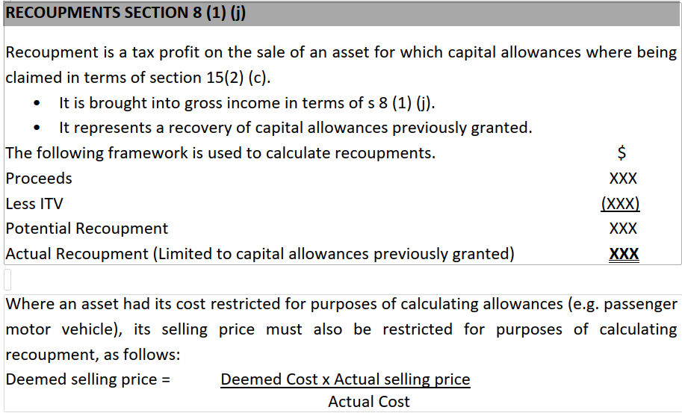
Recoupment ( 8)(1)(1) and 81j

Slide 27
Recoupment Example
A taxpayer purchased the following assets in the 2010 tax year, a passenger motor vehicle for $15,000 and machinery for $40,000. During the 2013 tax year he sold them for $9,000 and $30,000 respectively.
Required: To calculate his recoupment in the current. Assume SIA was claimed.
Recoupment on damaged assets
Where recoupment arises on damage of an asset, and the sale proceeds are receivable through an insurance policy, the whole amount will not be taxable provided the tax payer satisfies the commissioner that:
1. Within a period of 18 months from the date of damage or destruction he has
2. Purchased or construct a similar asset thereof and that;
3. Such asset has been or will be brought into use within a period of 3 years from the date the original asset was damaged or destroyed.

Slide 28
Scrapping Allowance Para 4 of the 4th Schedule
Scrapping allowances are the equivalent of losses on the disposal of fixed assets used for trade. It arises when a scrapped asset is disposed of for proceeds that are less than the income tax value. Scrapping allowance is deducted in the determination of the taxpayer’s taxable income.
In a case where the asset has not been sold, the allowance can only be granted where the commissioner is satisfied that the asset has become useless for business purposes or has been discarded with no intention to use it again in the future.
When business organizations wind up operations, scrapping allowances will be allowed to the extent that it does not exceed the recoupment arising from the business closure
Example: Scrapping allowance
In January 2012 a taxpayer acquired a lorry for $16k which was to be used for the purpose of trade. The taxpayer elected to claim the maximum allowances available in terms of the 4th schedule. In June 2014 the lorry was scrapped as it had been involved in an accident and was damaged beyond repair. The taxpayer sold the scrap to a local garage for an amount of $2k. Required: Calculate the scrapping allowance available to the taxpayer.

Slide 29
Prohibited deductions s16
Private expenses are prohibited as a deduction
16(1) (c)- Any losses or expenses which are recoverable under any insurance indemnity e.g. insured stock that got rotten
Tax expense is disallowed as a deduction
Expenditure incurred on the production of exempt income – thus when you the splitting if there is a potion of exempt income
Interest on any capital employed
16(1)(i) -The rent of, or cost of repairs to, or expenses incurred on, any premises not occupied for trade, or of any dwelling or domestic premises except in respect of such part as may be occupied for the purposes of trade.
16(1)(L)-The cost of any shares awarded by the company to an employee or director. This prohibition would counter any claim for a deduction by a company in respect of either an issue of its own

Slide 30
Prohibited deductions s16
8. 16(1)(m) Expenditure incurred on entertainment, whether directly or by the provision of an allowance to any employee, including a director. “Entertainment” is defined as including “hospitality in any form”.
Except to the extent that it’s incurred for business,
9. 16(1)(o) Expenditure incurred in the production of interest on any loan or deposit with a local financial institution.
Thin Capitalization rules
Taxpayers are privy to the tax deductibility of interest, however, sometimes taxpayers overdo it and use this to evade tax hence:
16(1)(q)-Any expenditure incurred by a local branch or subsidiary of a foreign company, or by a local company or subsidiary of a local company, in servicing any debt or debts contracted in connection with the production of income to the extent that such debt or debts cause the person to exceed a debt to equity ratio 3:1
> The prohibited portion of the dividend is treated as dividend distribution in terms of the Company Act (COBE) hence it’s subject to withholding tax as per section 26(2) and 28(2)

Slide 31
Prohibited deductions s16
Example
D Ltd is the Zimbabwe subsidiary of A Ltd, a company listed in India. During the year ending 31st December 2013, D Ltd borrowed $2 million from A Ltd to fund capital expenditure. Interest of $ 200,000 was paid on the loan. The statement of financial position of D Limited reflected that it had equity of $500,000 and long-term debt of $2,5million
Step 1- Compute the debt-to-equity ratio
DE Ratio = 2,5m/0,5m=5:1
Step 2 – Compute or check for the current interest paid
In this case the interest paid was $200 000
Step 3- Computed the allowable deduction potion as below
> Its is computed as = (limit debt to equity ratio /current D/E ratio as computed in step 1)*interest in step 2
Details |  | Amount
Interest paid |  | $200 000,00
Allowable |  | $120000,00
Disallowed Portion |  | $80 000,00

Slide 33
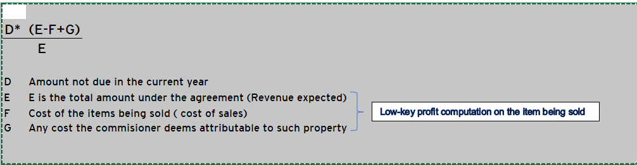
Suspensive sale Section 17 and 18
Sections 17 and 18 applies to the sales of movable or immovable assets where ownership is transferred at either the paying the full consideration promised or when an agreed portion has been settled ,
Since income is accrued (gross income 81a-Lategan Vs CIR) it means the taxpayer is will to be taxed on amounts on which he hasn’t received cash consideration, Hence the Commissioner pardons such transactions by granting a relief
Please note the relief is computed each year until the sale transaction is settled
Formulae ( this same principle will be covered under CGT)

